Slide 1
The Birds, the bees and STDS 3/3/16
Catalyst: List everything you did today (appropriate) from waking up to arriving at school.
Reflection:
37L
37R

Slide 2
Relationship Web
1. Get 4 people in this class to write their name on your index card.
2. Number them in the order they sign it: 1, 2, 3, 4.
3. When everyone in the class has 4 signatures sit down.

Slide 3
Reproductive Facts
There are 61 million U.S. women in their childbearing years (15–44).
About 43 million of them (70%) are at risk of unintended pregnancy.
Couples who do not use any method of contraception have an approximately 85% chance of experiencing a pregnancy over the course of a year.
Knowledge about contraceptive methods is a strong predictor of use among young adults: In a 2012 study among unmarried women aged 18–29, for each correct response on a contraceptive knowledge scale, women’s odds of currently using a hormonal or long-acting reversible method increased by 17%, and their odds of using no method decreased by 17%

Slide 4
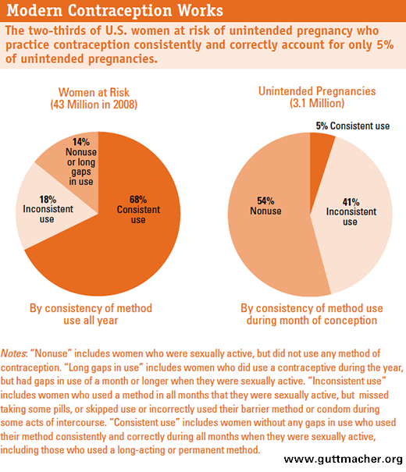

Slide 5
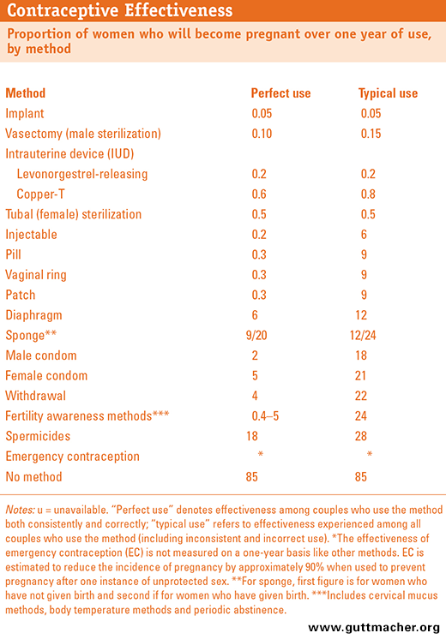

Slide 6
Every year, 3 million teens acquire an STI.
That’s 1 in 4 sexually active teens.

Slide 7
More than 65 million people in the U.S. are currently living with an STI, and almost 1 million are infected with HIV.

Slide 8
What are STIs?
Sexually transmitted infections are passed from an infected person through sexual activity that involves the anus, vagina or penis.

Slide 9
How are STIs spread?
Body fluids including blood, semen, and vaginal secretions. These fluids can be passed from partner to partner during vaginal, anal, or oral sex.
Skin-to-skin contact. This can happen when rubbing genitals, or when one person touches another’s genitals and then touches his/her own.

Slide 10
What are the common STIs?
Syphillis
Genital Herpes
Chlamydia
Gonorhhea
Mycoplasma Genitalium
6. Trichomoniasis
7. Crabs/Pubic Lice
8. Scabies
9. Human Papillomavirus/HPV
10. HIV/AIDS

Slide 11
What’s wrong?
Each group will become afflicted with one of the ten most prevalent STDs
As a group, you will be in charge of investigating:
1. Symptoms
2. Treatment options
3. Preventative measures
On the CDC website: http://www.cdc.gov/std/default.htm

Slide 12
What’s wrong?
As a group, you will be in charge of investigating:
1. Symptoms
2. Treatment options
3. Preventative measures
On the CDC website: http://www.cdc.gov/std/default.htm
You will be presenting your found informtion to the class so everyone can record it in their notebooks.

Slide 13
The Birds, the bees and STDS 3/3/16
Catalyst: List everything you did today (appropriate) from waking up to arriving at school.
Reflection: What can you do to protect yourself against the ten most common STDs. What can you do to protect yourself against an unwanted pregnancy?
37L
37R

